Slide 1
URBAN HEAT ISLAND IMPACT ASSESSMENT:- MYSORE CITY

Slide 2
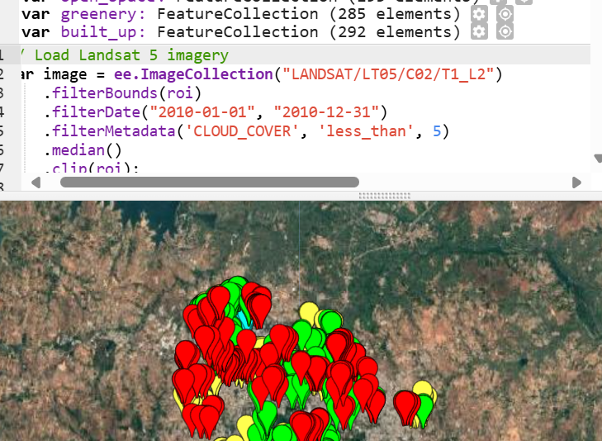
Land use land cover (lulc):-
It is a crucial concept in environmental and geographical studies, representing two related but distinct aspects of the Earth’s surface:
Land Cover: Refers to the physical material on the surface of the Earth, such as vegetation, water bodies, bare soil, built-up areas, and more. This aspect describes what is actually present on the land (e.g., forest, grassland, agricultural fields).
Land Use: Refers to the human activities or purposes that are associated with a specific land cover. This includes how people use the land for agriculture, residential or commercial purposes, recreation, conservation, and industrial activities.

Slide 3
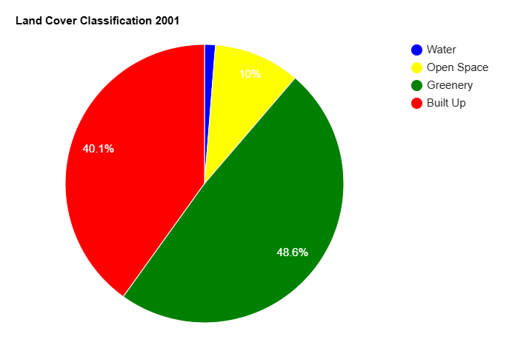
LAND USE LAND COVER (LULC)-2001:-

Slide 4
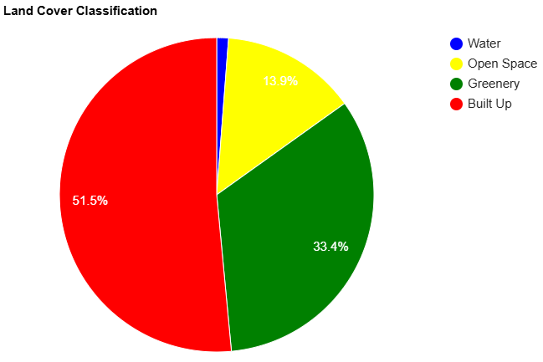
LAND USE LAND COVER (LULC)-2010:-

Slide 5
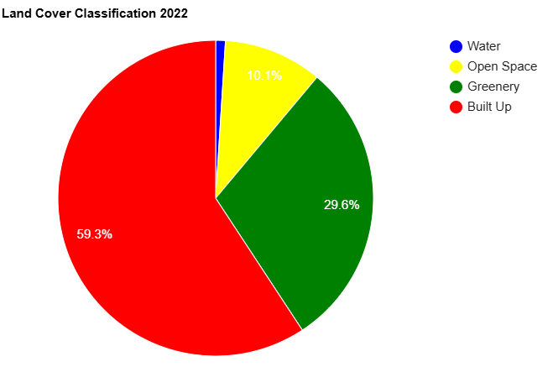
LAND USE LAND COVER (LULC)-2022:-

Slide 6
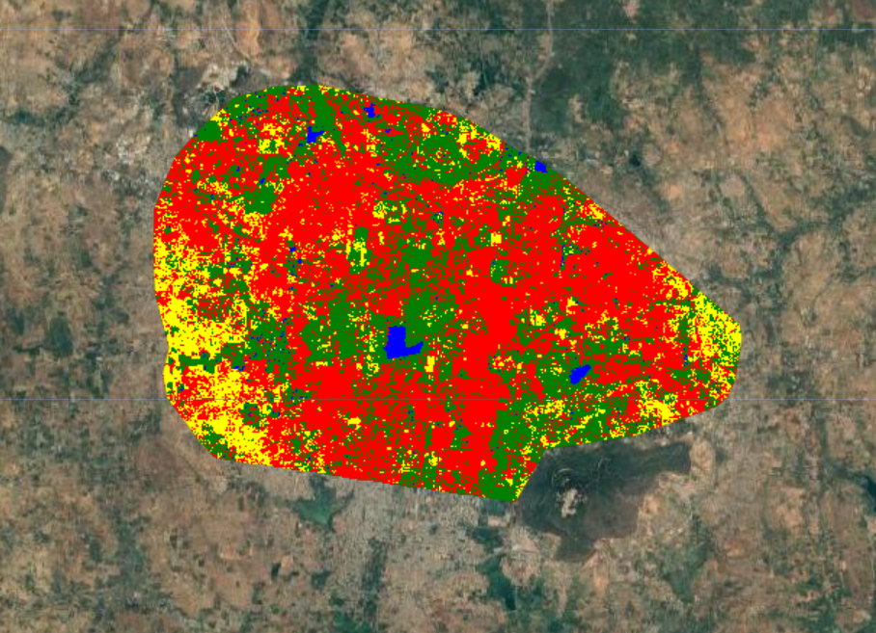
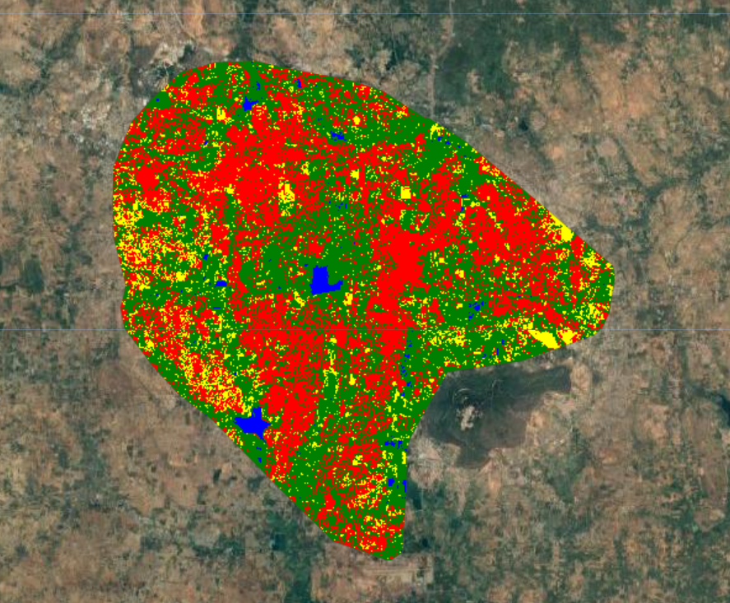
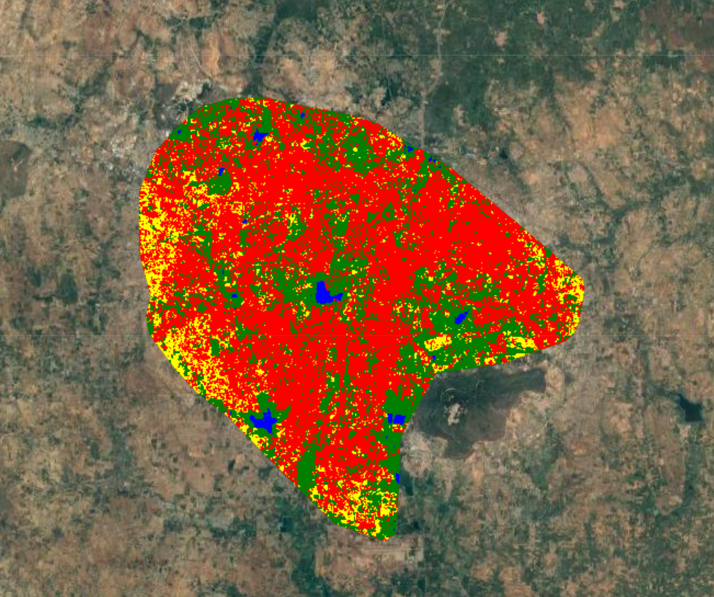
ANNUAL LULC maps:-
2001
2022
2010

Slide 7
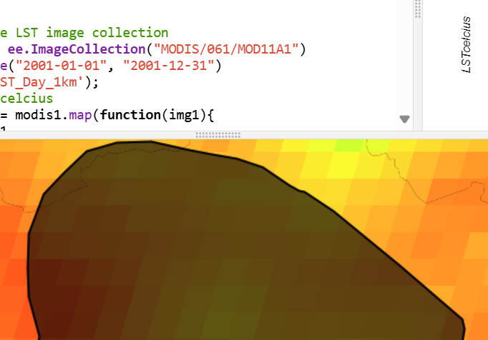
Land surface temperatures(lst):-
refers to the temperature of the Earth's surface as measured from above, typically by satellites. It represents the heat emitted by the ground surface and includes the effects of land cover types, such as soil, vegetation, water bodies, and urban infrastructure.

Slide 8
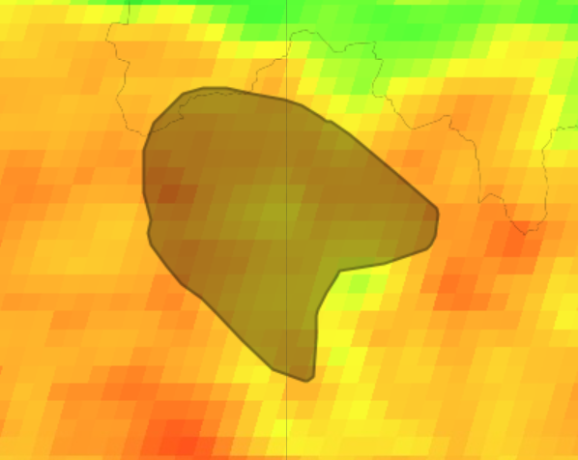
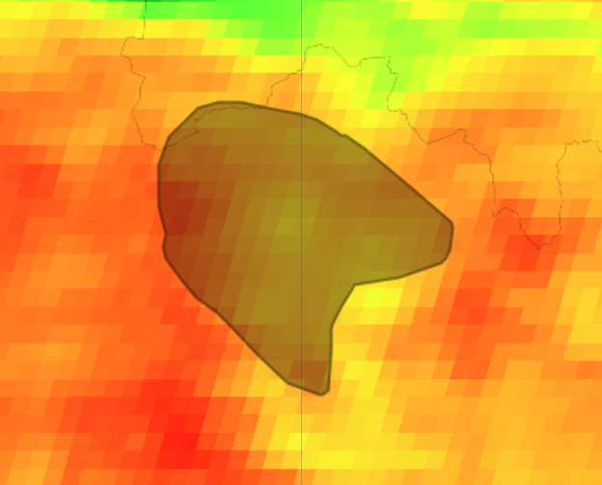
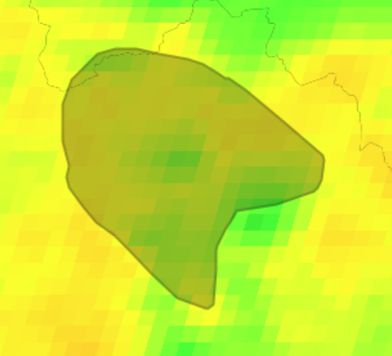
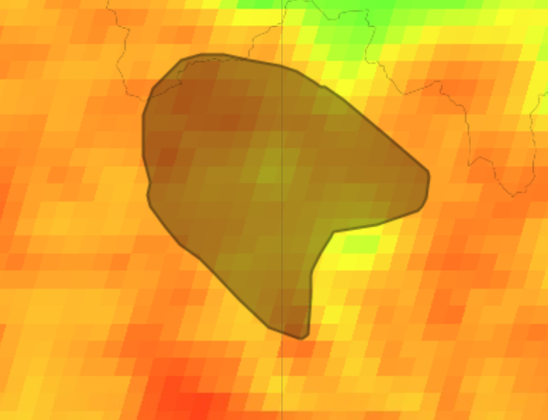
ANNUAL Lst map:-
2010
2022
2001
2019

Slide 9
REASON FOR SUDDEN DIP IN MEAN TEMPERATURES after 2019:-
The decline in mean temperatures in Mysore after 2019 can largely be attributed to the impacts of the COVID-19 pandemic. During this period, there was a significant decrease in human activities, which directly and indirectly influenced local climate conditions. The key factors include:
Reduction in Air Pollution: Lockdowns and restrictions on travel led to a sharp decrease in vehicle emissions, industrial activities, and construction. This resulted in lower levels of greenhouse gases and particulate matter in the atmosphere, reducing the heat trapped by pollutants. The cleaner air allowed more sunlight to escape back into space, contributing to lower temperatures.
Decrease in Urban Heat Generation: Urban areas typically experience the Urban Heat Island (UHI) effect, where human activities, vehicle emissions, and industrial processes elevate local temperatures. During COVID-19 lockdowns, reduced human presence and lowered energy consumption in commercial areas lessened the UHI effect, bringing down temperatures.
Changes in Land Use: Some urban areas saw a temporary "greening" effect as natural vegetation grew more freely in the absence of human interference. This increase in greenery provided additional shade and reduced surface heating in certain areas.
Global Climate Influence: The global slowdown also meant reduced emissions on a larger scale, which may have contributed to minor cooling effects that were reflected locally. Though small, this impact, combined with local factors, played a role in lowering mean temperatures.

Slide 10
LST TREND ANALYSIS:-
The variation in mean tertile temperatures of Summer (March, April, May, June) and Winter (November, December, January, February) from
2001-2022 used for LST projection of years 2028-30.

Slide 11
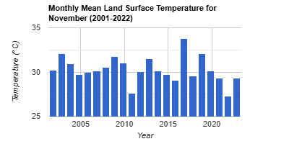
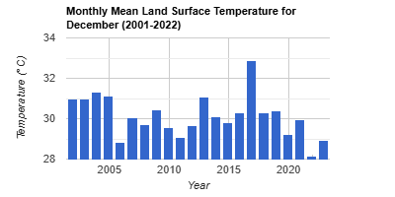
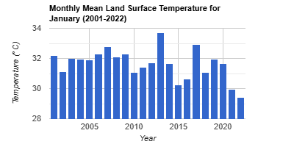
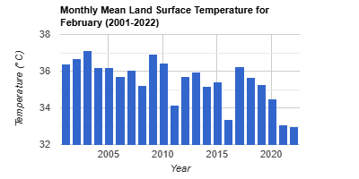
MEAN MONTHLY TEMPERATURES (WINTER MONTHS):-

Slide 12
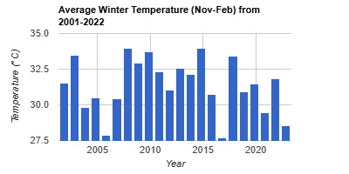
MEAN MONTHLY TEMPERATURES (WINTER MONTHS):-

Slide 13
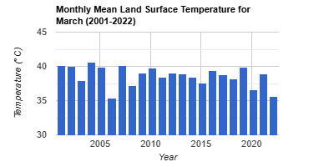
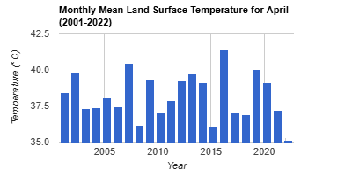
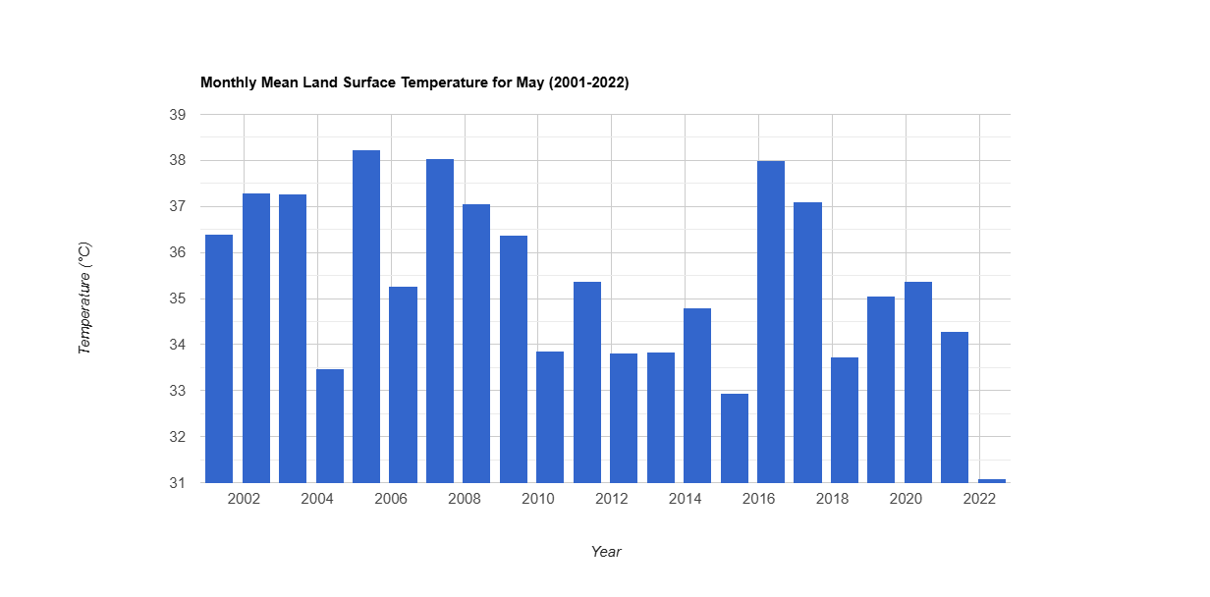
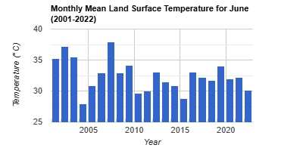
MEAN MONTHLY TEMPERATURES (SUMMER MONTHS):-

Slide 14
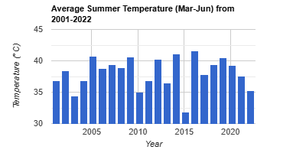
MEAN MONTHLY TEMPERATURES (summer MONTHS):-

Slide 15
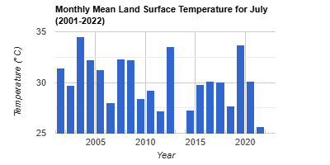
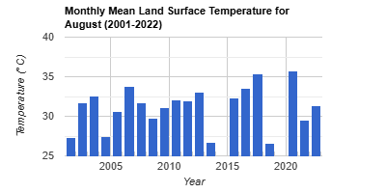
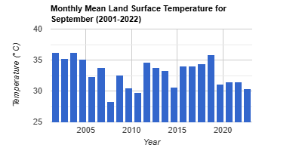
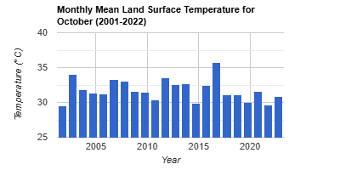
MEAN MONTHLY TEMPERATURES (MONSOON MONTHS):-

Slide 16
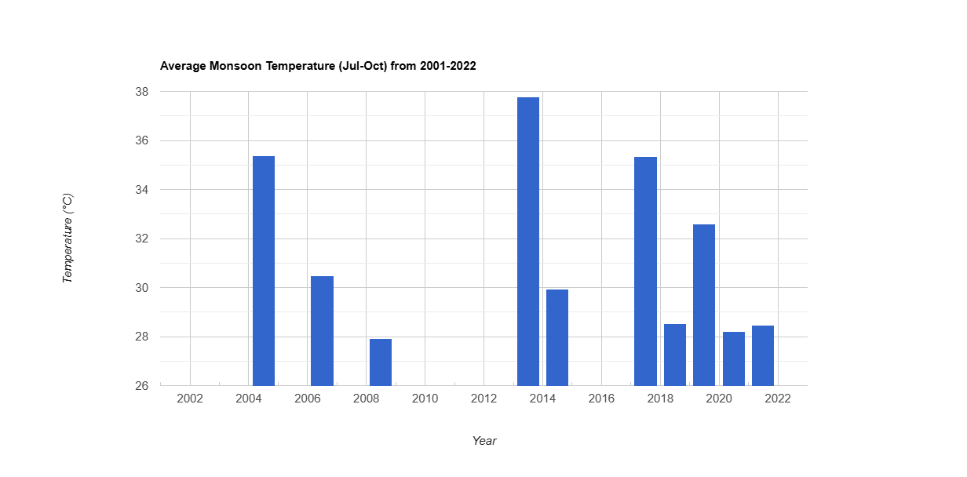
MEAN MONTHLY TEMPERATURES (MONSOON MONTHS):-

Slide 17
PROJECTION 2028-2030:-

Slide 18
LULC PROJECTION:-
Method used for the projection is Linear Regression on GEE.
ENTITY | 2001 | 2010 | 2022 | 2030
BUILT UP | 40.1% | 51.5% | 59.3% | 67.4%
GREENERY | 48.6% | 33.4% | 29.6% | 20.6%
OPEN SPACE | 10% | 13.9% | 10.1% | 11.1%
WATER | 1.3% | 1.2% | 1% | 0.9%

Slide 19
Lst projection:-
Time | Temp. |  | Time | Temp. |  | Time | Temp.
Jan 1, 2028 | 31.788 |  | Jan 1, 2029 | 31.776 |  | Jan 1, 2030 | 31.763
Feb 1, 2028 | 33.88 |  | Feb 1, 2029 | 33.784 |  | Feb 1, 2030 | 33.688
Mar 1, 2028 | 36.997 |  | Mar 1, 2029 | 36.963 |  | Mar 1, 2030 | 36.928
Apr 1, 2028 | 39.356 |  | Apr 1, 2029 | 39.382 |  | Apr 1, 2030 | 39.409
May 1, 2028 | 33.654 |  | May 1, 2029 | 33.537 |  | May 1, 2030 | 33.42
Jun 1, 2028 | 31.191 |  | Jun 1, 2029 | 31.089 |  | Jun 1, 2030 | 30.988
Jul 1, 2028 | 29.942 |  | Jul 1, 2029 | 29.92 |  | Jul 1, 2030 | 29.899
Aug 1, 2028 | 36.089 |  | Aug 1, 2029 | 36.247 |  | Aug 1, 2030 | 36.404
Sep 1, 2028 | 30.69 |  | Sep 1, 2029 | 30.597 |  | Sep 1, 2030 | 30.504
Oct 1, 2028 | 31.745 |  | Oct 1, 2029 | 31.734 |  | Oct 1, 2030 | 31.723
Nov 1, 2028 | 29.111 |  | Nov 1, 2029 | 29.107 |  | Nov 1, 2030 | 29.103
Dec 1, 2028 | 29.936 |  | Dec 1, 2029 | 29.923 |  | Dec 1, 2030 | 29.911

Slide 20
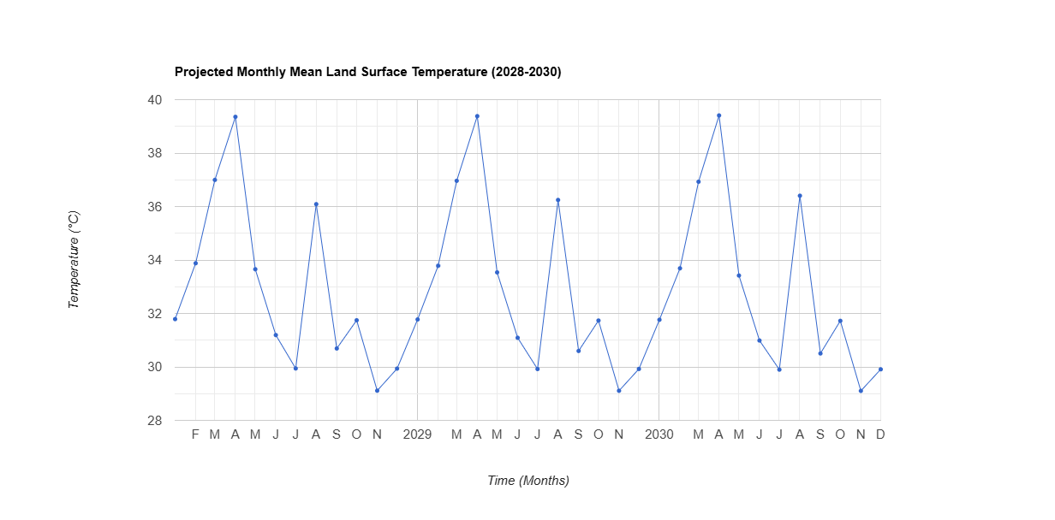

Slide 21
Thank you
, ,
, ,
SPECIAL THANKS :-
TA MAYANK UPADHYAY SIR
Assessing the impact of land use land cover changes on land surface temperature over Pune city, India – ScienceDirect
Kashyap Jyoti Gohain, Pir Mohammad, Ajanta Goswami

